Slide 1
Version 1.1
Gate Drivers
Presenter: Bipolar Business Unit
Date: November 2018
Notes:
Welcome to this presentation on Gate Drivers.
In this presentation we will go through the process of selecting and optimising the Gate Driver for your application.
We will split this into three areas:
Selection and Design-in Criteria
Key external component selection
Optimal layout considerations

Slide 2
Selection and/or Design-in Criteria
How many inputs/outputs required from the Gate Driver ?
Required Voltage rating
Drive current rating
Special functions
Key external component selection
Notes:
Initially we will need to specify our selection and / or design in criteria.
This includes:
The number of inputs and outputs that are required for the application
The maximum voltage rating required by the application
The maximum drive current rating required by the application,
And any special functions that the Gate driver must offer.
Finally, key external components can be specified to optimise the design.

Slide 3
Selection and/or Design-in Criteria
How many inputs/output are provided for/by the Gate driver?
For the inputs, It depends on the choice of the micro controller and the control algorithm chosen by the designer
For 2 inputs, the choice is high-side / low-side gate driver
For 1 input, the choice is a half-bridge driver
Number of outputs depend on the number of half bridges that require driving
How to select the voltage rating?
A conservative rule is to pick a voltage rating 3 times the operating voltage, with 1.5 times being a recommended minimum. However, this depends purely on the system requirements and usually set by the designer
Gate drivers always work with MOSFET/IGBT, best practise is to match the voltage rating of the chosen MOSFET/IGBT
Notes:
The number of inputs and outputs are dictated by the application, such as, is it a high-side / low-side driver, half bridge driver and the number of gates that need driving.
The voltage range is dictated by the application and operating environment. It is important to consider ringing, transients other stresses that may occur. If the MOSFET or IGBT has already been specified, then match the voltage rating of that part. Otherwise pick a rating at least 1.5 times the maximum operating voltage of the application.

Slide 4
Selection and/or design in criteria
How much drive current is required?
Information about the required gate charge to raise the gate voltage to the desired level is essential
Gate charge information is provided by the MOSFET manufacturer in their datasheet, usually for a gate voltage of 10V
Now that we know the required gate charge, we choose the drive current rating depending on the rise and fall times we are targeting. The equation to use is Qg = Igate * time
Example: Qg = 50nc. Required Tr = 50ns and Tf = 25ns.
Igate (source) = 50/50 = 1A of source current.
Igate(sink) = 50/25 = 2A of sink current.
The above calculation provides you with a minimum figure. Often it is not easy to find a tailored gate driver. Best practice is to choose a gate driver with higher than the required rating and use series gate resistors to limit the source and sink currents
Notes:
In order to achieve the correct switching profile for the application it is essential that we can sink and source enough current to the gate.
To calculate the currents we need to know the required rise and fall times and the gate charge required for full saturation.
We can then use the formula “ I = Q / t “ to calculate the required sink and source capability of the driver.
It’s a good idea to use a gate driver with higher drive capability and use a series network to obtain the correct currents.
This also offers the opportunity to fine tune the circuit during evaluation.

Slide 5
Selection and/or Design-in Criteria
Special functions
Some applications need special functions like inbuilt and/or adjustable dead time, enable option, shoot through prevention logic, delay matching etc. to ensure the selected gate driver comes with the required optional features.
Key external component selection
Boot strap capacitor selection
Gate resistor selection
Layout recommendations for managing switch node noise
Notes:
The application should be considered carefully to establish if specific gate drive functions are required in order to operate correctly.
These functions may include dead time , enable or disable control, shoot through prevention, delay matching etc.
Having established our specification and selected our Gate Driver, we now need to optimise the design by:
Selecting the correct boot strap capacitor
Selecting the correct gate drive components
Optimising the PCB layout.

Slide 6
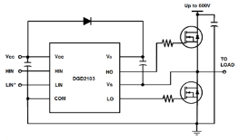
Bootstrap Capacitor Selection
The capacitance of the bootstrap capacitor should be high enough to provide the charge required by the gate of the high-side MOSFET. As a general guideline, it is recommended to make sure the charge stored by the bootstrap capacitor is about 50 times more than the required gate charge at operating V_{CC} (usually about 10V to 12V).
The formula to calculate the charge in C_{BS} to provide sufficient gate charge is shown below; Q = C * V where Q is the gate charge required by the external MOSFET . C is the bootstrap capacitance and V is the bootstrap voltage V_{BS}
Example: To switch a high-side MOSFET that requires 20nC of gate charge to raise
its gate voltage to 10V, the capacitor size can be calculated as below;
QG(MOSFET) = C(BOOTSTRAP) * V(BOOTSTRAP) * 50
C_{BS} = Q_{G} / V_{BS} = 20nC / 10V * 50 = 100nF
Notes:
To turn on the high side MOSFET a bootstrap circuit is used to raise and maintain the gate source voltage to about 10 volts during on time.
As we know the gate voltage and gate charge, we can calculate the capacitance from the formula “C equals Q over V”
As a general rule a safety margin of 50 times the capacitance is considered good.

Slide 7
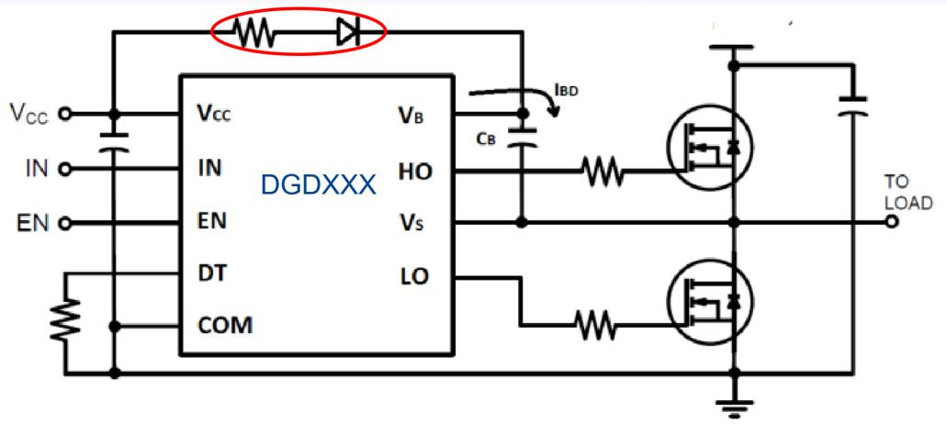
Bootstrap Diode selection
Some of the DGDXXX series gate drivers come with an internal bootstrap diode
Where an external bootstrap diode is necessary, designer should choose its voltage and current ratings appropriately
V_{R} rating of the bootstrap diode should be >= the voltage rating of the gate driver OR the MOSFETs, whichever is lower.
Though the average current flowing though the bootstrap diode under normal operation is very small, it is important to consider the start-up current. When the system is first powered, there will be an inrush current flowing into the bootstrap diode
Inrush current is directly proportional to the size of the bootstrap capacitance. Larger the capacitance, larger will be the inrush current. Hence it is important to follow the design recommendations in the previous slide while choosing the capacitor. Also a series current limiting resistor is recommended almost every time
Optimum capacitor size and appropriate series resistance combination is important to avoid any unnecessary stresses on the bootstrap diode
Notes:
The purpose of the bootstrap diode is to maintain the charge in the bootstrap capacitor.
However, during initial start-up when the capacitor is discharged, there may be a rush of current into the capacitor.
We should consider the effects of this on both the Diode and Capacitor. Very often a series resistor will be used as illustrated to limit the inrush current.

Slide 8
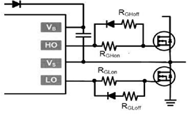
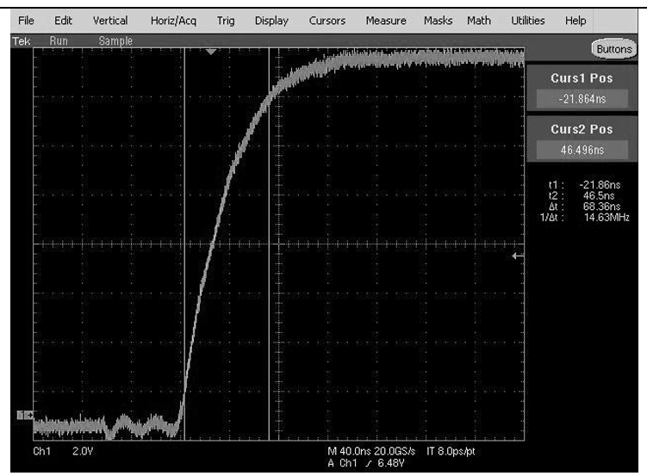
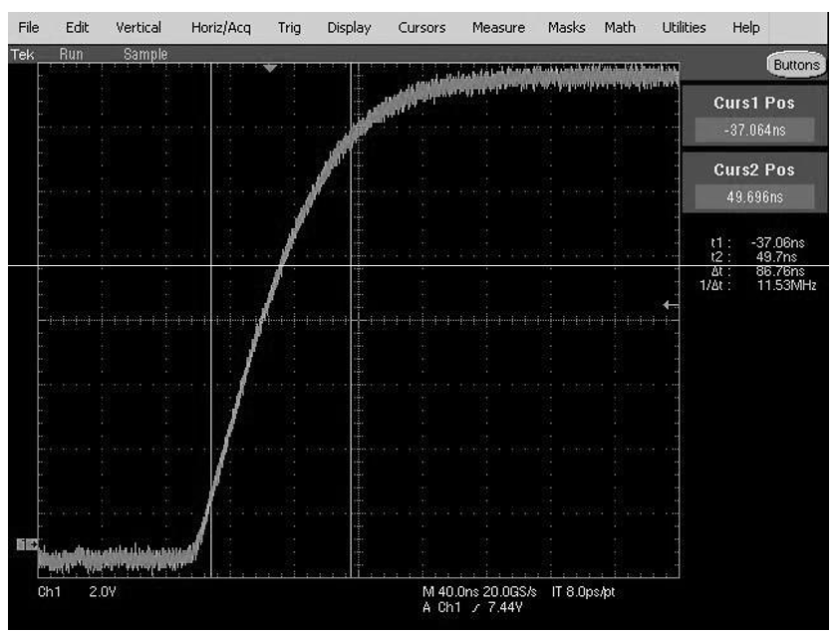
Gate Resistor Selection
A typical gate drive current control circuit is shown here.
By adjusting the R_{Gon} and R_{Goff} resistors respectively, the rise and fall times can be controlled individually
The effect of the gate resistance on the switching time is shown in the below example, where the on-time is increased from 68ns to 86ns
Notes:
As we discussed earlier, the gate drive rise and fall times can be controlled with a series circuit as illustrated here.
In this circuit the fall will be shorter than the rise time due to the diode polarity.

Slide 9
Switch Node Noise Management
Switch node shown in the figure as V_{S}, is the noisiest node in the half-bridge circuits.
DGDxxxx series gate drivers come with a good 50V/ns immunity at the switch node, however for meeting certain EMI specifications a few layout techniques are recommended below
Tracks connecting the HO and LO pins to the gates must be made as wide and short as possible
A correct combination of high side and low side gate resistance help minimise the switch node noise significantly
The track length between the high side MOSFET’s source pin and low side MOSFET’s drain pin must be as short as possible
Decoupling capacitors must be placed as close as possible between the Vcc and COM pins
Low ESR capacitors are ideal for boot strapping applications
Notes:
Now we have our design complete we must design our PCB.
Of course we have large currents and fast switching edges which lead to large transition swings.
To alleviate ringing and reflections we need to reduce inductance in the connections, and the easiest way to do this is to make the tracks as wide and short as possible and reduce current loop lengths by keep ing components as close together as possible.
High frequency harmonics can be reduced by increasing the gate drive rise and fall times, but this is a trade off with switching losses.
Decoupling capacitors should always be close to the component they are decoupling in order to reduce series reactance.
Finally, ground planes under the wide tracks will create significant capacitance so beware!

Slide 10
Thank you
Notes:
Thank You

